Slide 1
Image Classification of Handwritten Numerals using Neural Network

Slide 2

Sanjeev Sinha Chris Casey Shaheen Pouya
Auburn Neural Tigers

Slide 3
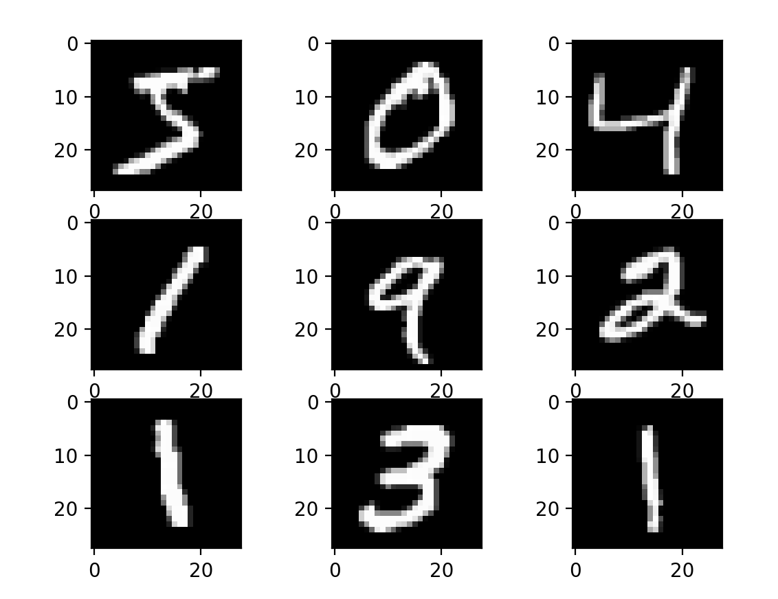
Image Classification
MNIST dataset
http://yann.lecun.com/exdb/mnist

Slide 4
MNIST Dataset
Training: 60000 examples
Testing: 10000 examples
A subset of a larger set NIST
Normalized
Centered
Fixed-size

Slide 5
The main steps
Pre-Processing
Data loading
Main Model
Back Propagation
Test
Adding noise

Slide 6
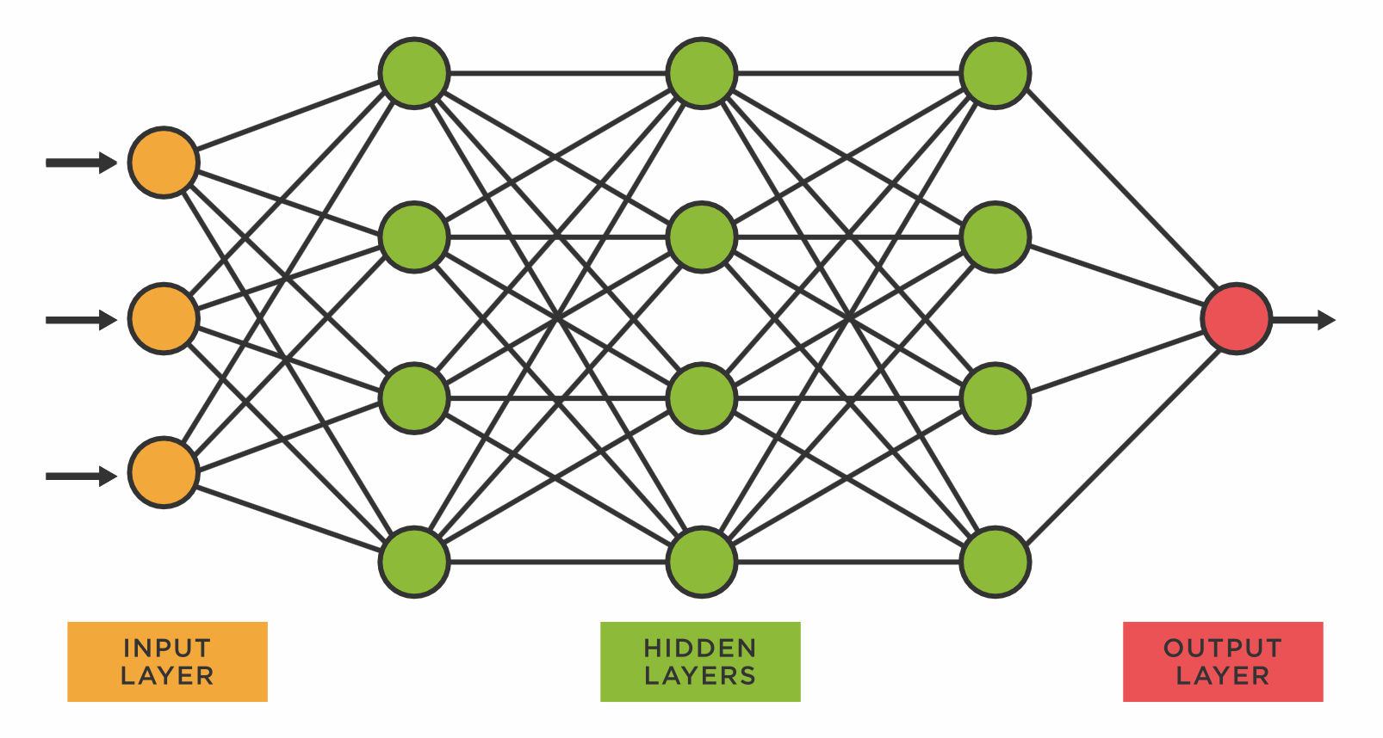
Pre-processing
Input Layer: 28 x 28 Pixel Images
Output Layer: 0-9 Digits (10 output nodes)
Customized hidden layers with 786 nodes
Data files:
train-images-idx3-ubyte
train-labels-idx1-ubyte
t10k-labels-idx1-ubyte
t10k-images-idx3-ubyte

Slide 7
Pre-processing
Used Packages | Purpose
Github | Version Control/Collaboration
Numpy/Pandas | Data Processing/Management
Struct | Extracting data into arrays
Matplotlib | Graphical Output

Slide 8
Pre-processing
Building class:
class MNIST_Dataloader
Functions for getting training and testing data:
def get_train_data(self):
x_train, y_train = self.read_image_labels(self.training_images_path, self.training_labels_path)
return x_train, y_train
def get_test_data(self):
x_test, y_test = self.read_image_labels(self.test_images_path, self.test_labels_path)
return x_test, y_test
Notes:
If you have ever cashed a check using your smart phone, then you know the type of impact this technology has. It saves you a trip to the bank…

Slide 9
Pre-processing
Reading data:
struct.unpack(">II", labels_file.read(8)) For labels
struct.unpack(">IIII", images_file.read(16)) For images
Getting 784 elements from stream into numpy array:
for i in range(size):
image = np.array(image_data[i * rows * cols: (i + 1) * rows * cols])
image = image.reshape(28, 28)
images[i][:] = image

Slide 10
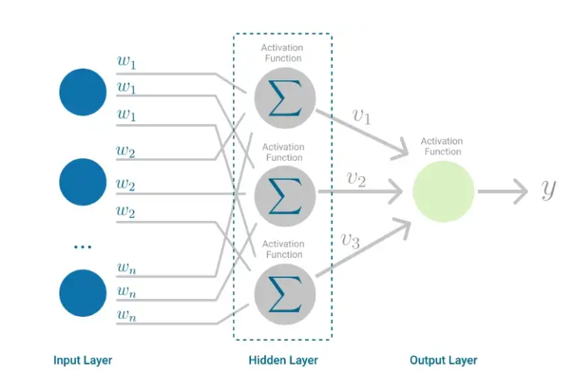
Multilayer perceptron

Slide 11
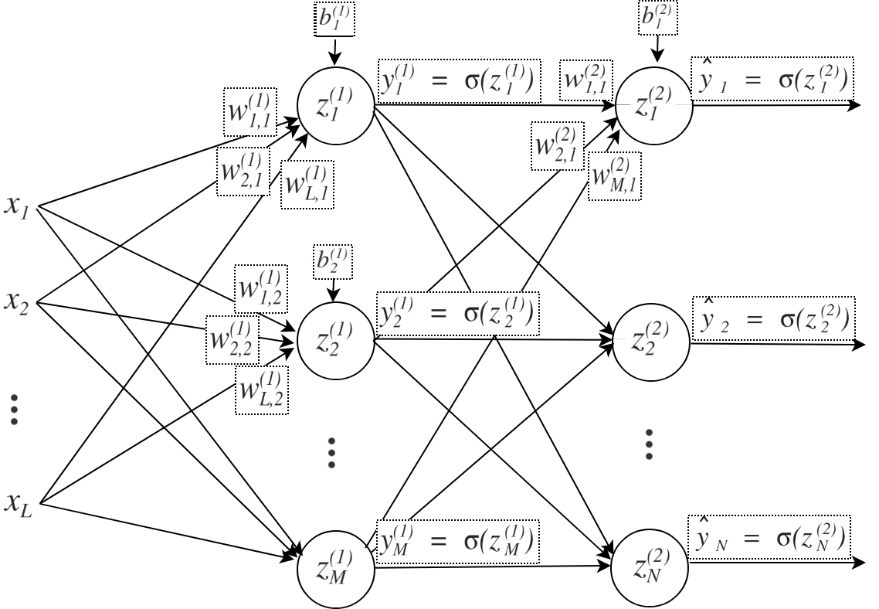
Feed Forward

Slide 12
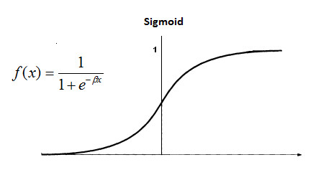
Sigmoid Function
Notes:
Hyperparameters [epochs, # neurons in the hidden layer, learning rate, etc] will be plotted with respect to Accuracy, Precision, F1 Score throughout the project. This will help us visualize and track model’s performance throughout development.

Slide 13
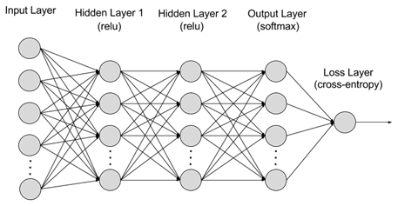
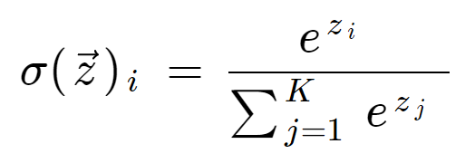
Softmax Function
Notes:
Hyperparameters [epochs, # neurons in the hidden layer, learning rate, etc] will be plotted with respect to Accuracy, Precision, F1 Score throughout the project. This will help us visualize and track model’s performance throughout development.

Slide 14
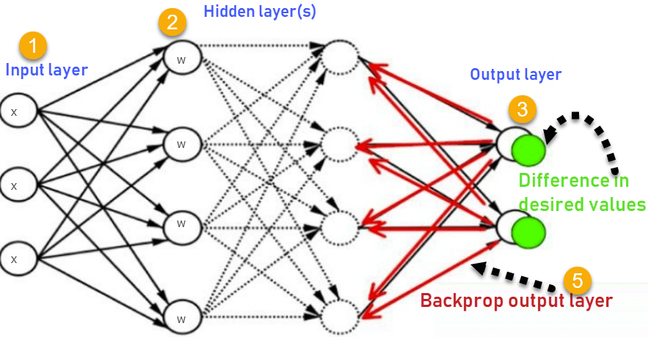
Backpropogation

Slide 15
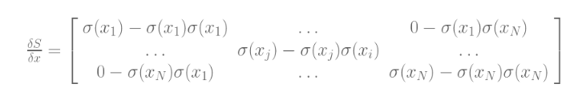
Softmax derivative

Slide 16
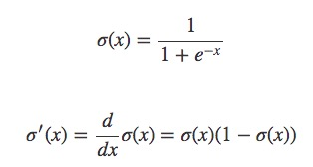
Sigmoid derivative

Slide 17
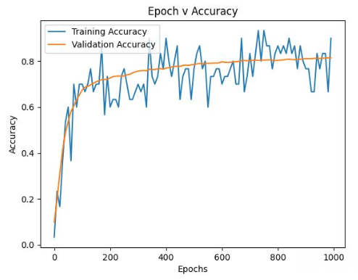
Results 1
Notes:
Hyperparameters [epochs, # neurons in the hidden layer, learning rate, etc] will be plotted with respect to Accuracy, Precision, F1 Score throughout the project. This will help us visualize and track model’s performance throughout development.

Slide 18
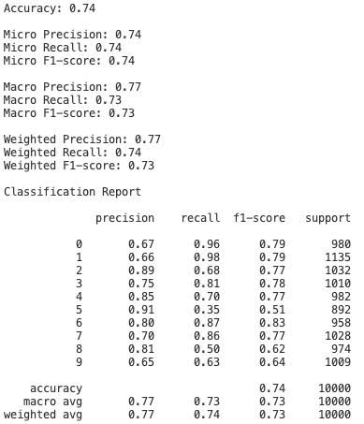
Results 2
Notes:
Hyperparameters [epochs, # neurons in the hidden layer, learning rate, etc] will be plotted with respect to Accuracy, Precision, F1 Score throughout the project. This will help us visualize and track model’s performance throughout development.

Slide 19
Using data loader in the main model
Testing data loader
dataloader.simple_show() a simple instance to show 9 images of handwritings
dataloader.show_images(5,5) an instance to show any number of images
from MNIST_Dataloader import MNIST_Dataloader
Notes:
The MNIST database (Modified National Institute of Standards and Technology database) is a large database of handwritten digits that is commonly used for training various image processing systems. We chose this dataset as it is a subset of the much larger and commonly used NIST database. As the M, which stands for modified, implies, the images in this datasets have been size-normalized and centered in a fixed-size image. 28x28. This dataset is advantageous as it reduces the amount data preprocessing and formatting we need to do.
Another benefit of choosing a dataset source is that it provides baselines of different models for comparison.

Slide 20

Thanks!

